Slide 1
Algoritmer & Datastrukturer Greatest Hits
5. december 2025

Slide 2
Recursion – a method that calls itself
public static int f(int x)
{
if (x == 0)
return 0;
else
return 2*f(x-1) + x*x;
}
Base
Making progress towards base case
The problem is reduced on the way down (divide)
A solution is generated on the way back up (conquer)

Slide 3
More recursion
public static void printOut(int n)
{
if (n >= 10)
printOut(n / 10);
System.out.print(n % 10);
}
Base case
Work towards the base case.
Design rule: assume that the recursive step works.
Avoid solving the same instance of the problem repeatedly (remember recursive Fibonacci).

Slide 4
Advantages of using recursion
You do not need to keep track of all the recursive calls, which can be a complicated exercise.
This is being handled by mechanisms in the operating system, which control the nested method calls with activationrecords in the runtime-stack.
Some also claim that recursive methods are easier to understand than iterative ones. Others disagree.

Slide 5
Verification
Recursive algorithms are rare examples that it can be proven mathematically that a program is flawless. This is because of their inductive nature.
With larger programs comprehensive verification is practically impossible in accordance with the claim that a program is only flawless until you find the next error.

Slide 6
N is used to denote the number of elements
to be sorted
to be inserted into a list
(nodes/edges) in a graph
in a list/array to be traversed

Slide 7
Rules of thumb
Halving problem: O(log N)
One for-loop: O(N)
Two for-loops in sequence: O(N)
for-loop with halving: O(N log N)
Two nested for-loops: O(N²)
Three nested for-loops: O(N³)
Check all combinations: O(2^{N})

Slide 8
Different cases
Best
Average
Worst

Slide 9
The next step
Algorithms
vs.
Artificial Intelligence

Slide 10
Hashing – briefly
Abstract datatype, where objects can be fetched and stored in constant time – O(1) – or almost.
Requires that each object has a unique key; otherwise retrieval is impossible.
The objects are stored in an array with the size of a prime number (probing).
High performance requires that the objects are distributed uniformly in the array.
The load factor is denoted λ and is equal to the number of elements in the table divided by the table size, thus always <= 1.00.

Slide 11
Hashing
… is a typical example of a tradeoff, which means that you get something by giving up something else.
In this case you gain speed by giving up space.
Most hashing implementations require at least twice as much space as the actual data takes up, in order to obtain the constant time speed for inserting and fetching data.

Slide 12
Hashings problem
No matter how good a hash funtionen you choose, it will occur that two objects hash to the same index in the array.
This is called a collision.
Collisions can be overcome in different ways:
Separate chaining
Linear probing
Quadratic probing
Double hashing
These are rather simple strategies. More complex ones will follow.

Slide 13
Quadratic probing
If TableSize is a prime greater than 3 and the load factor is less than 0.5, a vacant spot can always be found using quadratic probing.

Slide 14
Hopscotch-hashing
An improval of linear probing.
In certain modern architechtures proximity is more important than the number of probes.
Hardly no need for rehashing if λ < 0,5.
Is superior to Cuckoo-hashing on most parameters.

Slide 15
Hopscotch example

Slide 16
Hopscotch example

Slide 17
Priority queue
Background: the need to execute queues by a different principle than FIFO.
Examples: printjobs, CPU-scheduling, urgent orders.
Necessary operations: insert and deleteMin.
Elegant ADT can ensure insert with O(log N) as opposed to anticipated O(N).

Slide 18
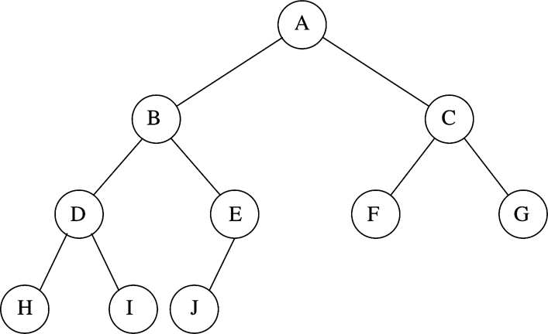
Priority queue – complete binary tree elements are added from left to right at the lowest level

Slide 19
Implementation

Slide 20
buildHeap()
Suppose you have a list (an array) of unsorted numbers.
Make a complete binary tree of all the elements.
Call percolateDown()for all the nodes under the root starting with the rightmost deepest which is not a leaf.
Building the heap is O(N).

Slide 21
Why is buildHeap() important?
Sorting is an extremely important exercise.
Trivial sorting algorithms have quadratic time complexity.
Using buildHeap() you can achieve O(N log N).
First you build a heap from your unsorted numbers. That takes N operations.
Then you call deleteMin() on all elements. That takes N log N operations. And your numbers are sorted.
N + N log(N) -> O(N log N).

Slide 22
Inversion
Take a look at this list of integers:
34, 8, 64, 51, 32, 21
The numbers are clearly unsorted so let’s see if we can measure out just how unsorted they are.
To assist us we can define a concept called inversion. An inversion is an ordered pair of numbers (i,j), for which i < j, but a[i] > a[j].
In our example the following inversions occur:
(34,8) (34,32) (34,21) (64,51) (64,32) (64,21) (51,32) (51,21) (32,21)

Slide 23
Sorting
The more inversions the list contains, the more unsorted it is.
The discipline of sorting is to reduce the number of inversions in a list of integers to zero.

Slide 24
More about inversions
The average number of inversions in a list of N distinct integers is N(N-1)/4.
If one operation can eliminate one inversion, that kind of sorting must have quadratic time complexity.
If more than one inversion can be removed in one operation, we might be able to do better than quadratic.

Slide 25
O(N²)
Insertionsort
Selectionsort
Bubblesort

Slide 26
O(N logN)
Mergesort
Heapsort
Quicksort

Slide 27
bucketSort()
Under certain circumstances we can do better than O(N log N).
If we need to sort positive integers with a maximum value M, we can solve the problem by creating an array sized M.
The numbers are read from one end to the other and reading value X, index X in M is incremented by one.
When all the numbers have been read, the array is output in accordance with the number of occurrences in the indexes.
Time complexity O(M+N) -> O(N).

Slide 28
Conclusion
Inversions
O(N²)
O(N log N)
O(N)
Choose the most appropriate considering the circumstances.
The issue is in most cases not essential if there are less than 10,000 elements, and sorting thus can be performed in memory.

Slide 29
Introduction to trees
Linked lists with their linear access time are not feasible for large amounts of data.
We could use a simple data structure with an access time of O(log N).
An option is the binary search tree.
In general trees are frequently used in computer applications.
Collection classes set and map are based on trees.

Slide 30
Binary search tree
Definition: balance condition – the depth of the tree is O(log N).
Thus the search time is likewise O(log N).
This can be ruined if the tree becomes left- or right-heavy due to consecutive deletions or insertions.

Slide 31
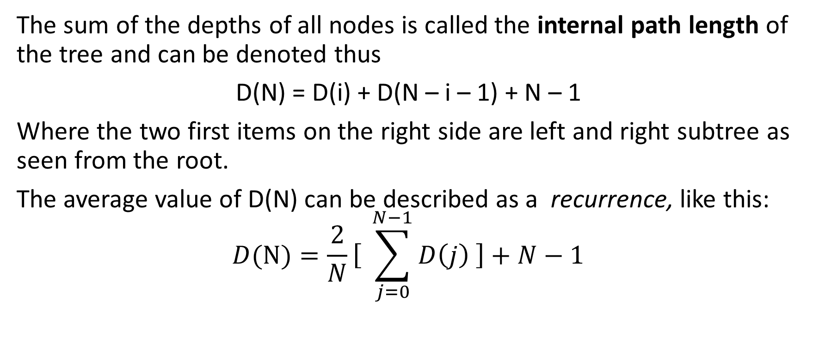
Average case Analysis
The sum of the depths of all nodes is called the internal path length of the tree and can be denoted thus
D(N) = D(i) + D(N – i – 1) + N – 1
Where the two first items on the right side are left and right subtree as seen from the root.
The average value of D(N) can be described as a recurrence, like this:
$$D(N)=\frac{2}{N}\left[ \right.\sum_{j=0}^{N−1}{D\left(j\right)\left. \right]+N−1}$$

Slide 32
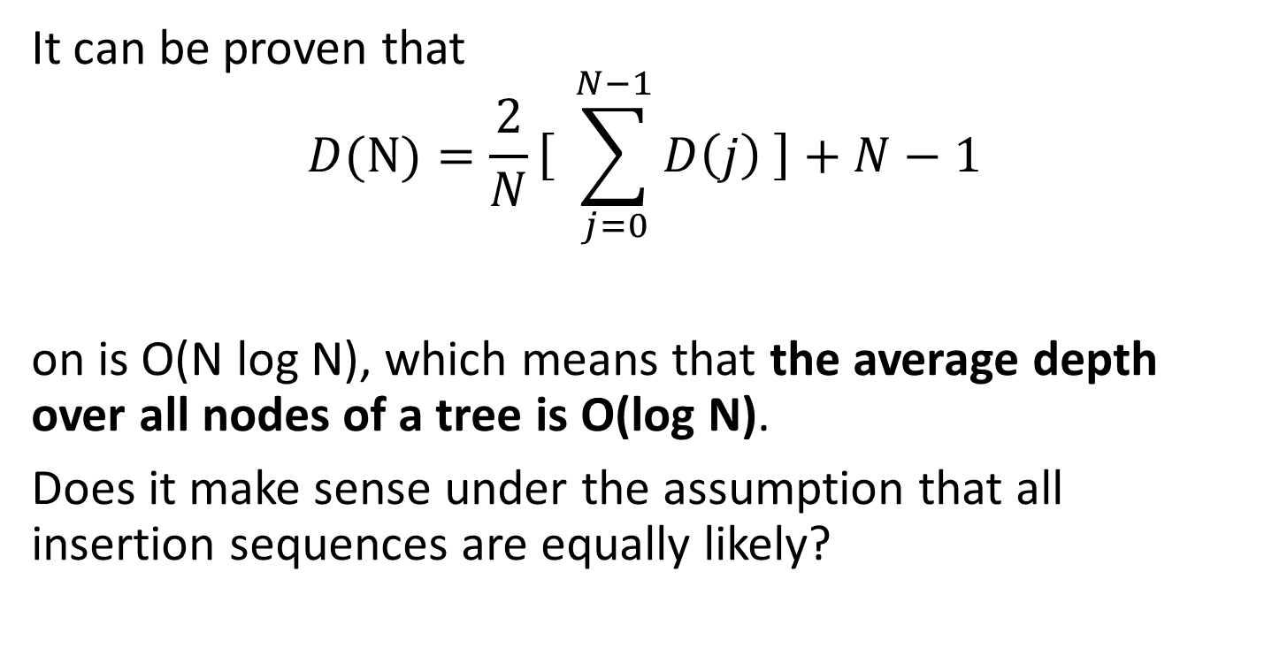
Average case analysis
It can be proven that
$$D(N)=\frac{2}{N}\left[ \right.\sum_{j=0}^{N−1}{D\left(j\right)\left. \right]+N−1}$$
on is O(N log N), which means that the average depth over all nodes of a tree is O(log N).
Does it make sense under the assumption that all insertion sequences are equally likely?

Slide 33
The AVL-tree
AVL ~ Adelson-Velskii & Landis.
An AVL-tree has a balance condition.
That is, for every node in the tree, the variation of the height of left and right subtrees is no more than 1.
Modification of the tree ensuring the balance condition is called rotation.
Difference between binary search tree (BST) and AVL-tree: BST: average depth is O(log n); AVL: maximum depth is O(log n).

Slide 34
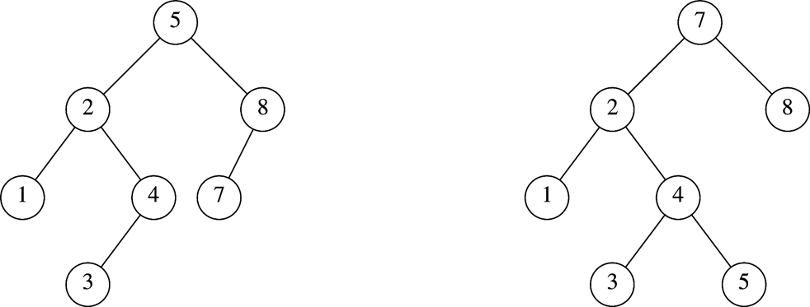
AVL and non-AVL

Slide 35
Rotation
After the insertion of a new node (e.g. 6 in previous slide), the tree may be unbalanced.
Single rotation can solve the problem.

Slide 36
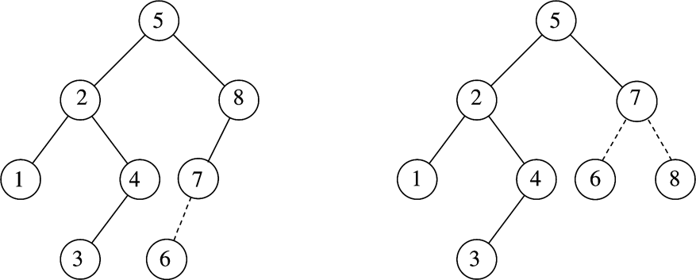
Single rotation

Slide 37
Rotation
The need for rotation may occur in four cases:
Insertion into the left subtree of the left child of α.
Insertion into the right subtree of the left child of α.
Insertion into the left subtree of the right child of α.
Insertion into the right subtree of the right child of α.

Slide 38
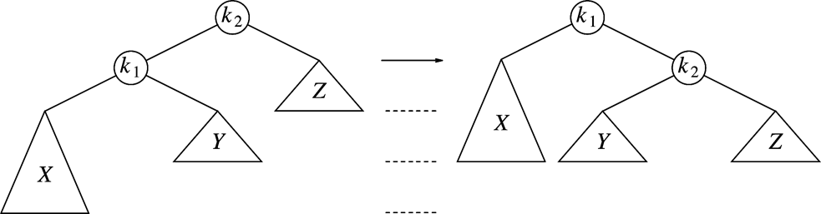
private AvlNode<AnyType> rotateWithLeftChild( AvlNode<AnyType> k2 )
{
AvlNode<AnyType> k1 = k2.left;
k2.left = k1.right;
k1.right = k2;
k2.height = Math.max(height(k2.left),height(k2.right) ) + 1;
k1.height = Math.max(height(k1.left),k2.height ) + 1;
return k1;
}

Slide 39
doubleWithLeftChild()
private AvlNode<AnyType> doubleWithLeftChild( AvlNode<AnyType> k3 )
{
k3.left = rotateWithRightChild( k3.left );
return rotateWithLeftChild( k3 );
}

Slide 40
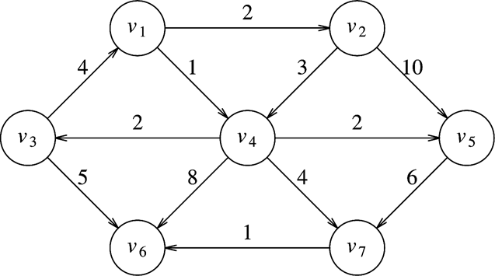
Graphs –weighted shortest path - Dijkstra

Slide 41
Graphs –weighted shortest path - Dijkstra )
About Edsger Dijkstra (1930-2002) and his algorithm:
Developed in the 1970’s.
He claimed that ”the go to-statement must be considered harmful”
Problem reduction: chess board and dominoes.
Greedy algorithm; solves the problem in stages by always choosing what seems to be the best option.
Always picks the closest node.
Does not work with negative costs.
O(|E| log|V|) using appropriate data structure.

Slide 43
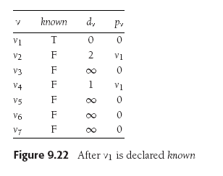

Slide 44
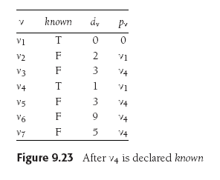

Slide 49
Minimum spanning tree
Undirected, connected graph
Connect all nodes with minimal cost.
Often more than one solution
Can be performed on directed graphs

Slide 50
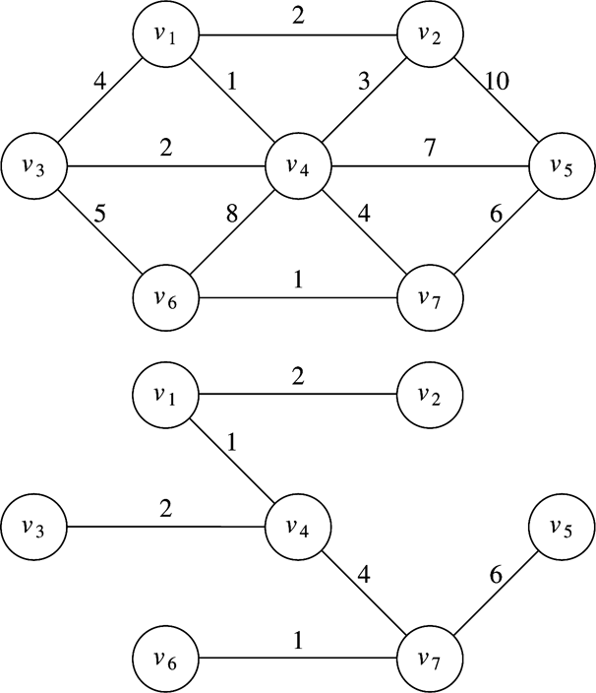
Prim

Slide 51
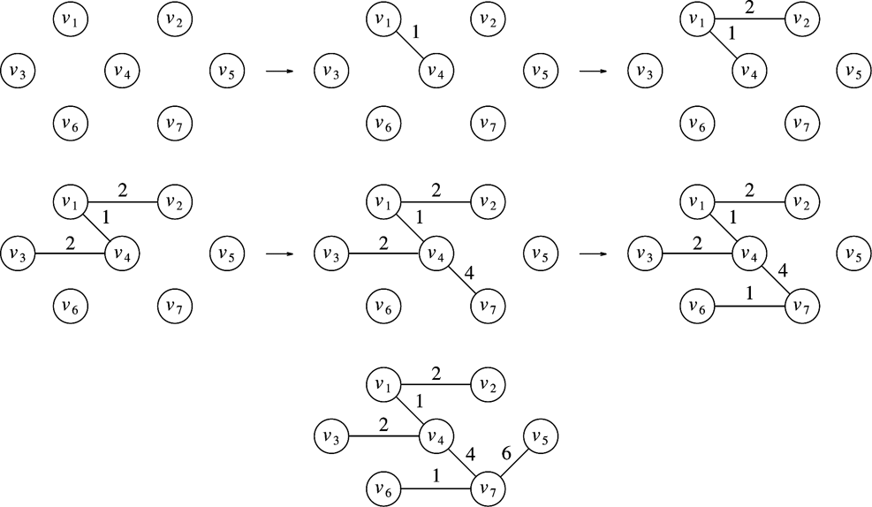
Prim

Slide 52
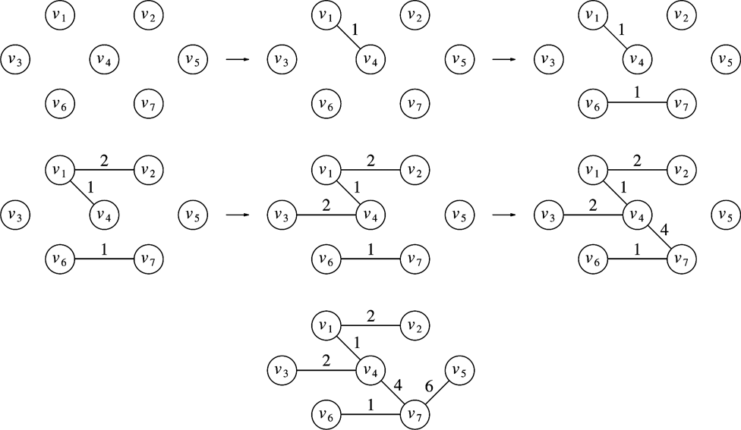
Kruskal

Slide 53
Kruskal pseudocode

